Slide 1
Mass Storage Technologies

Slide 2
Agenda
Explain how the drives work, beginning with the internal layout and organization of drives
Identify mass storage interface connections
Describe how to protect data with RAID
Describe hard drive installation

Slide 3
How Hard Drives work
Hard drives come in 2 major types:
The traditional type with moving parts;
And a newer, more expensive technology with no moving parts.

Slide 4
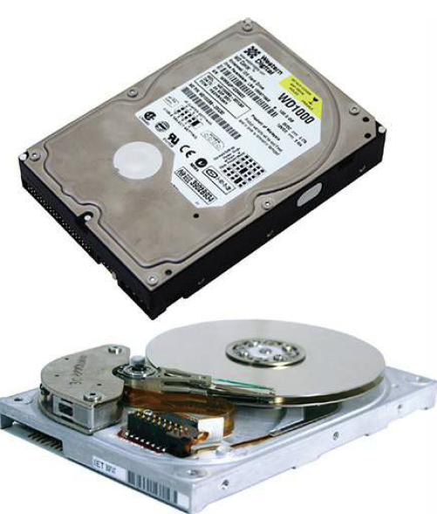
How Hard Drives work
Magnetic Hard Drives
A traditional hard disk drive (HDD) is composed of individual disks, or platters, with read/write heads on actuator arms controlled by a servo motor - all contained in a sealed case that prevents contamination by outside air.
The aluminum platters are coated with a magnetic medium. Two tiny read/write heads service each platter, one to read the top of the platter and the other to read the bottom of the platter. Each head has a bitsized transducer to read or write to each spot on the drive.
Magnetic Hard Drives

Slide 5
How Hard Drives work
Magnetic Hard Drives
A traditional hard disk drive (HDD) is composed of individual disks, or platters, with read/write heads on actuator arms controlled by a servo motor - all contained in a sealed case that prevents contamination by outside air.
The aluminum platters are coated with a magnetic medium. Two tiny read/write heads service each platter, one to read the top of the platter and the other to read the bottom of the platter. Each head has a bitsized transducer to read or write to each spot on the drive.
Magnetic Hard Drives

Slide 6
How Hard Drives work
Hard drives run at a set spindle speed, with the spinning platters measured in revolutions per minute (RPM).
Older drives ran at a speed of 3600 RPM, and drives are sold with speeds up to 15,000 RPM. The faster the spindle speed, the faster the drive stores and retrieves data.
The two most common speeds are 5400 and 7200 RPM.
Faster drives generally equate to better performance, but they also generate more noise and heat. Excess heat cuts the life of hard drives dramatically.
Spindle (or Rotational) Speed

Slide 7
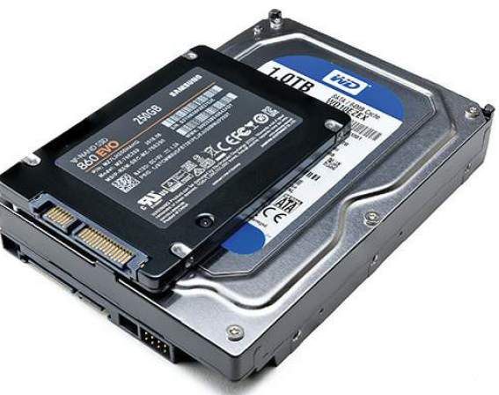
How Hard Drives work
Form Factors
Magnetic hard drives are manufactured in two standardized form factors, 2.5-inch and 3.5-inch.
The form factor only defines size. The connections and the storage technology inside these drives can vary.
Magnetic Hard Drives

Slide 8
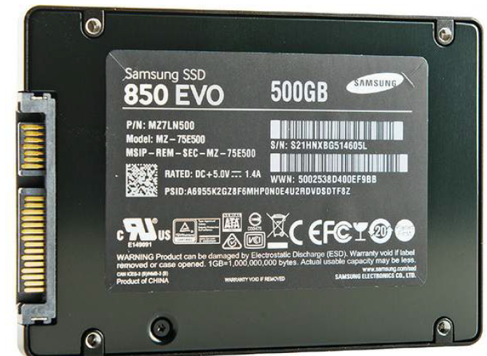
How Hard Drives work
Solid-State Drives (SSD)
Disadvantages of HDDs:
Booting up a computer takes time in part because a traditional hard drive needs to spin up before the read/write heads can retrieve data off the drive and load it into RAM.
All of the moving metal parts of a platter-based hard drive use a lot of power, create a lot of heat, take up space, wear down over time, and take a lot of nanoseconds to get things done.
Solid-state technology and devices are based on the combination of semiconductors and transistors used to create electrical components with no moving parts.
In simple terms, SSDs use flash memory chips to store data instead of all those pesky metal spinning parts used in platter-based hard drives
Solid-state technology is commonly used in desktop and laptop hard drives, memory cards, cameras, USB thumb drives, and other handheld devices.
Solid-State Drives (SSD)

Slide 9
How Hard Drives work
Solid-state drives operate internally by writing data in a scattershot fashion to high-speed flash memory cells in accordance with the rules contained in the internal SSD controller. That process is hidden from the operating system by presenting an electronic façade to the OS that makes the SSD appear to be a traditional magnetic hard drive
Solid-State Drives (SSD)

Slide 10
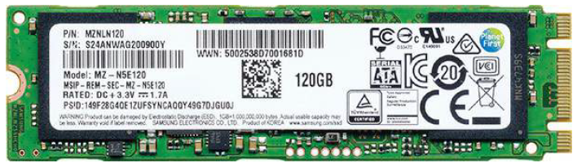
How Hard Drives work
Form factors for PCs
2.5 inch form factor
mSATA
M.2
mSATA and M.2 drives connect to specific mSATA or M.2 slots on motherboards.
M.2 has replaced mSATA. M.2 is half the physical size and offers substantially better performance.
M.2 slots come in a variety, keyed for different sorts of mass storage uses.
The keys have a letter associated. M.2 slots that use Key B, Key M, or Keys B+M support mass storage devices. Other slots like Key A and Key E are used in wireless networking devices.
SSDs use nonvolatile flash memory such as NAND that retains data when power is turned off or disconnected.
Solid-State Drives (SSD)

Slide 11
How Hard Drives work
Cost
SSDs cost more than HDDs. Less expensive SSDs typically implement less reliable multi-level cell (MLC) memory technology in place of the more efficient single-level cell (SLC) technology to cut costs.
Solid-State Drives (SSD)

Slide 12
How Hard Drives work
Performance Variables
Sequential Read/Write Performance A common measure of a storage device’s top speed is its throughput, or the rates at which it can read and write long sequences of data. We usually express a device’s sequential read and sequential write throughput in megabytes per second (MBps). Most drives read a little faster than they write.
Traditional hard drives: 200MBps | SATA SSDs: 600MBps | NVMe SSDs: 2500MBps or faster.
Random Read/Write Performance Because real-world drives rarely get to read and write huge files all day, we also look at a drive’s random read, random write, and mixed random performance. Basically, we measure how many times per second a device can read or write small, fixed-size chunks of data at random locations on the drive.
The labels for these measurements often reflect the size of the data chunk (usually 4 KB), so you may see them called 4K Read, 4K Random Write, 4K Mixed, and so on. These measurements are all typically expressed as a number of input/output operations per second (IOPS), but you may also see them expressed in MBps. Traditional hard drives typically clock in at fewer than 150 IOPS, whereas the latest NVMe SSDs boast hundreds of thousands of IOPS.
Latency drive’s response time, access time, or latency, which measures how quickly it responds to a single request. Latency is usually expressed in milliseconds (ms) or microseconds (μs). Low-latency storage is critical for high-performance file and database servers, but the latency of most modern drives is fine for general use. Traiditonal hard drives: <20ms | SSDs < 1ms.
Solid-State Drives (SSD)

Slide 13
How Hard Drives work
Windows supports hybrid hard drives (HHDs), drives that combine flash memory and spinning platters to provide fast and reliable storage. (HHDs are also known as SSHDs.) The small SSD in these drives enables them to store the most accessed data in the flash memory to, for example, slash boot times and, because the platters don’t have to spin as much, extend the battery life for portable computers.
Apple computers can use a Fusion Drive, which offers the same concept as a hybrid hard drive. The Fusion Drive separates the hard drive and SSD; macOS does all the work about deciding what should go in the SSD.
Hybrid Hard Drives (HHDs)

Slide 14
Agenda
Explain how the drives work, beginning with the internal layout and organization of drives
Identify mass storage interface connections
Describe how to protect data with RAID
Describe hard drive installation

Slide 15
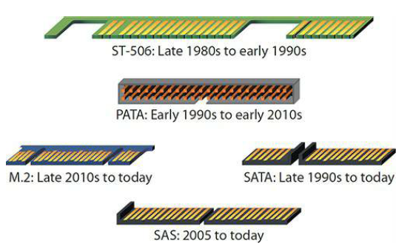
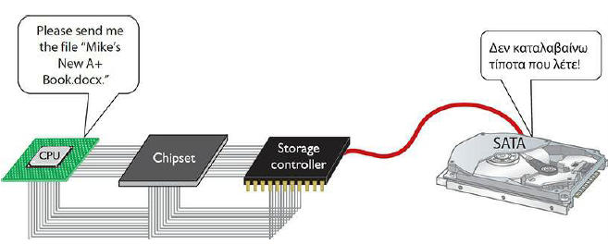
Connecting Mass Storage
Setting up communication between a CPU and a mass storage device requires 2 main items:
1. Standardized physical connections between the CPU, the drive controller and the physical drive.
2. The CPU needs to use a standardized protocol, sort of like a special language, so it knows how to speak to the mass storage to read and write data to the device.

Slide 16
Connecting Mass Storage
ATA (Advanced technology attachment) started with the version way back in 1990, going through ATA/ATAPI version 7.
Often referred to as integrated drive electronics (IDE) drives. The term IDE refers to any hard drive with a built-in controller. All hard drives are technically IDE drives, although we only use the term IDE when discussing PATA drives
Physical connections

Slide 17
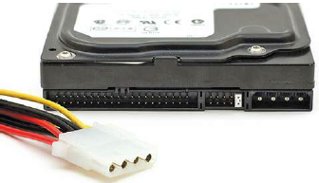
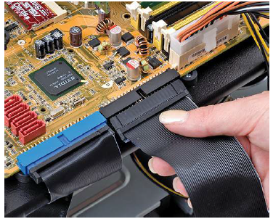
Connecting Mass Storage
PATA
Are easily recognized by the data and power connections. PATA drives used unique 40-pin ribbon cables (IDE cables). These ribbon cables usually plugged directly into a system’s motherboard.
All PATA drives used a standard Molex power connector.
A single PATA ribbon cable could connect up to two PATA drives—including hard
drives, optical drives, and tape drives—to a single ATA controller. You set jumpers on the drives to make one master and the other slave.
ATA went through seven major revisions, but they’re not particularly relevant for
modern techs. There is one feature added back then that we still use today,
though, called S.M.A.R.T.
ATA/ATAPI version 3 introduced Self-Monitoring, Analysis, and Reporting Technology (S.M.A.R.T.), an internal drive program that tracks errors and error conditions within the drive. This information is stored in nonvolatile memory on the drive and can be examined externally with S.M.A.R.T. reader software. There are generic S.M.A.R.T. reading programs, and every drive manufacturer has software to get at the vendor-specific information being tracked.
Physical connections - PATA

Slide 18
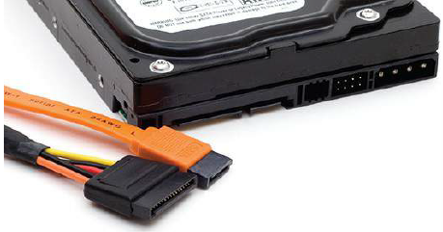
Connecting Mass Storage
Disadvantages of PATA:
the flat ribbon cables impeded airflow and could be a pain to insert properly. Second, the cables had a limited length, only 18 inches. Third, you couldn’t hot-swap PATA drives. You had to shut the computer down completely before installing or replacing a drive. Finally, the technology had simply reached the limits of what it could do in terms of throughput.
Serial ATA addressed these issues. SATA creates a point-to-point connection between the SATA device—magnetic hard drives, solid-state drives, optical media drives—and the SATA controller, the host bus adapter (HBA).
Physical connections - SATA
PATA | SATA
40 pin ribbon wires | 7 physical wires
Maximum cable length: 18 inches | Maximum cable length: 40 inches
Single ribbon cable connects up to 2 physical drives | Each drive connects to 1 port
Up to 133 MBps | 3 varieties: 1.5Gbps (SATA 1.0), 3 GBps (SATA 2.0), and 6 GBps (SATA 3.0), which have a maximum throughput of 150 MBps, 300 MBps, and 600 MBps, respectively.

Slide 19
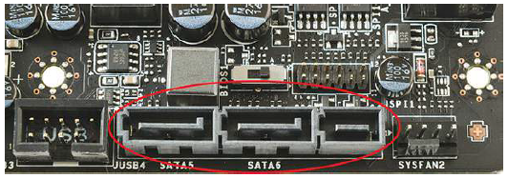
Connecting Mass Storage
SATA Express (SATAe) or SATA 3.2 ties capable drives directly into the PCI Express bus on motherboards. SATAe drops both the SATA link and transport layers, embracing the full performance of PCIe.
each lane of PCIe 3.0 capable of handling up to 8 Gbps of data throughput. A drive grabbing two lanes, therefore, could move a whopping 16 Gbps through the bus. Without the overhead of earlier SATA versions, this translates as 2000 MBps!
SATAe has unique connectors (see Figure 8-14) but provides full
backward compatibility with earlier versions of SATA. Note that the center
and left portions of the port look just like regular SATA ports. You can plug two regular SATA drives into a SATAe socket
Physical connections – SATA Express (SATAe)

Slide 20
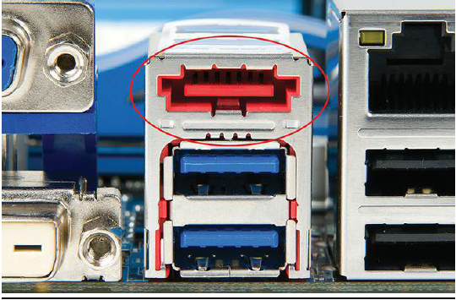
Connecting Mass Storage
eSATA and Other External Drives
Physical connections

Slide 21
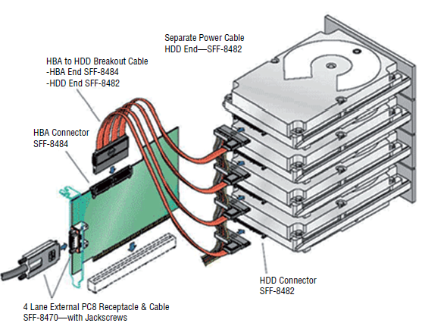
Connecting Mass Storage
Serial Attached SCSI (SAS) is a type of SCSI that uses serial operation rather than
parallel as the original SCSI did. There are several other ways in which it differs
from parallel SCSI. A SCSI bus is a multidrop bus (one on which multiple points of
attachment exist) whereas SAS uses point-to-point communication. Also, SAS requires no termination as in parallel SCSI.
The latest version of SAS, SAS-3, operates at 12.0 Gbps.
The cable plugged into the HBA is an external version of the SAS cable using the SFF-8470 connector, while the cable running from the HBA to the drives is an internal variety also called an octopus cable using the SFF-8484 connector to the HBA and SFF-8484 connector to the drives.
Physical connections
Serial Attached SCSI (SAS)

Slide 22
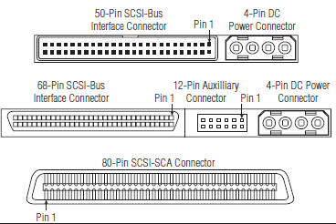
Connecting Mass Storage
The classic SCSI interface differs from SAS in that devices on the SCSI bus are like devices on a LAN and require SCSI IDs.
There are many versions of SCSI that differ in the width of the bus and the allowable length of the cables.
Internal parallel SCSI cables have two or more 50-, 68-, or 80-pin connectors attached. External cables have 50- or 68-pin connectors at each end, depending on the specific SCSI bus width supported.
An 80-pin Single Connector Attachment (SCA) is typically used for hot-pluggable devices. The latest version, Ultra 640 SCSI, can have only 16 devices on the bus and the cable cannot exceed 10 meters in length, but it can achieve 640 MBps.
Physical connections
SCSI

Slide 23
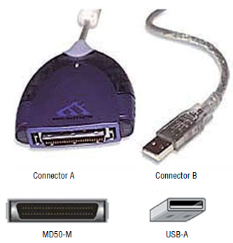
Connecting Mass Storage
USB can provide an interface to practically any type of device, including storage devices. This includes the ability to use special adapter cables to connect a SCSI drive to a USB 3.0 port using the UAS.
Physical connections
USB

Slide 24
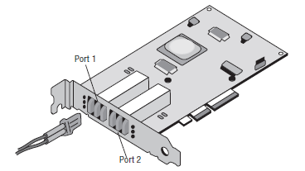
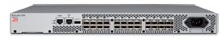
Connecting Mass Storage
Used to connect devices in a high-speed fiber storage network. These networks typically use a fiber switch with devices connected to the switch using Fibre Channel interfaces.
HBAs:
Servers will require some implementation of a fiber HBA, usually installed in one of the expansion slots, typically in a PCIe slot. HBAs can come in single or multiple port varieties.
Each HBA has a unique World Wide Name (WWN), which like a MAC address uses an Organizationally Unique Identifier (OUI) assigned by the IEEE. HBAs have two types of WWNs: one that identifies the HBA and is used by all ports on the HBA, and one that identifies each port on the HBA.
Fabric switches are those that support a Fibre Channel network
Physical connections
Fibre Channel

Slide 25
Connecting Mass Storage
AHCI and NVMe: current drive command sets for PC
SCSI command set: primarily for server
AHCI
Designed for spinning SATA drives to optimize read performance as well as to effect hot-swappability. It works for many SSDs as well, but it’s not optimal.
Using AHCI unlocks some of the advanced features of SATA, such as native command queuing and hot-swapping.
Native command queuing (NCQ) is a disk-optimization feature for SATA drives. It takes advantage of the SATA interface to achieve faster read and write speeds that are simply impossible with the old PATA drives.
Also, while SATA supports hot-swapping ability, the motherboard and the operating system must also support this. AHCI mode is enabled at the CMOS level and generally needs to be enabled before you install the operating system.
When you plug a SATA drive into a running Windows computer that does not have AHCI enabled, the drive doesn’t appear automatically. With AHCI mode enabled, the drive should appear in Computer immediately
Mass storage communication

Slide 26
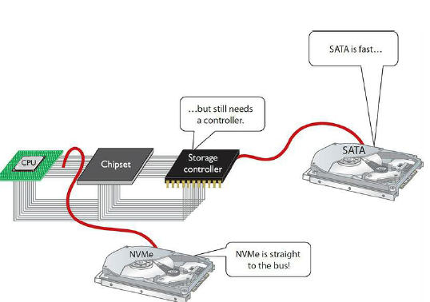
Connecting Mass Storage
AHCI and NVMe: current drive command sets for PC
SCSI command set: primarily for server
NVMe The Non-Volatile Memory Express (NVMe) specification supports a communication connection between the operating system and the SSD directly through a PCIe bus lane, reducing latency and taking full advantage of the wicked-fast speeds of high-end SSDs.
NVMe drives are more expensive than other SSDs, but offer much higher speeds. NVMe drives use SATAe
Mass storage communication
NVMe enables direct-to-the-bus communication

Slide 27
Connecting Mass Storage
AHCI and NVMe: current drive command sets for PC
SCSI command set: primarily for server
SATA drives dominate the personal computer market, but another drive technology, called the small computer system interface (SCSI), rules the roost in the server market.
SCSI drives used a variety of ribbon cables, depending on the version.
Serial Attached SCSI (SAS) hard drives provide fast and robust storage for
servers and storage arrays today.
The latest SAS interface, SAS-3, provides speeds of up to 12 Gbps.
SAS controllers also support SATA drives, which is cool and offers a lot of flexibility for techs, especially in smaller server situations.
Mass storage communication

Slide 28
Agenda
Explain how the drives work, beginning with the internal layout and organization of drives
Identify mass storage interface connections
Describe how to protect data with RAID
Describe hard drive installation

Slide 29
How to protect data with RAID

Slide 30
Agenda
Explain how the drives work, beginning with the internal layout and organization of drives
Identify mass storage interface connections
Describe how to protect data with RAID
Describe hard drive installation

Slide 31
Hard drive installation

